Slide 1
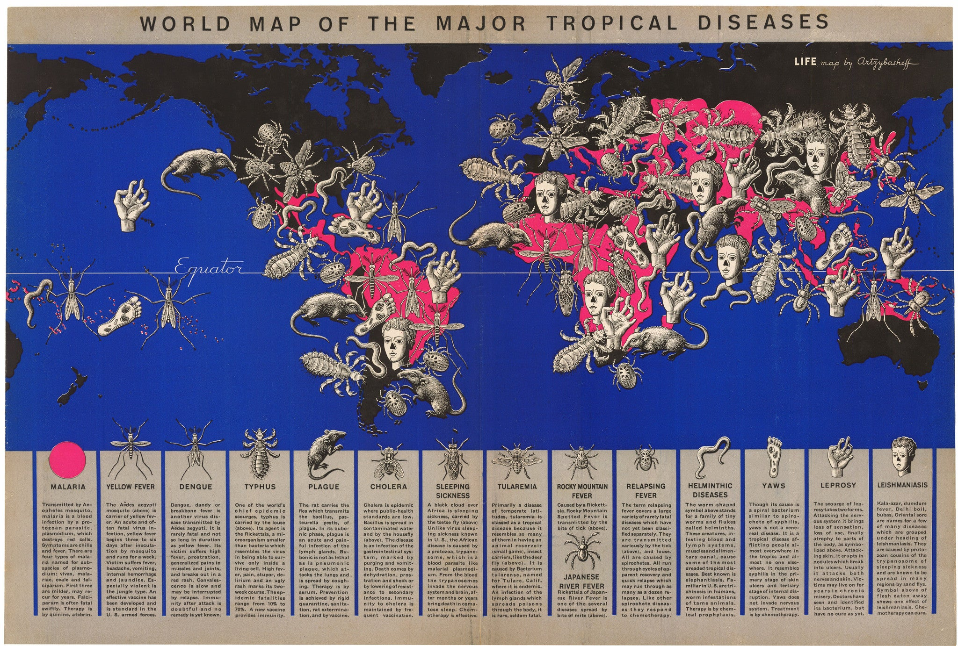
https://thevintagemapshop.com/products/1944-world-map-of-major-tropical-diseases

Slide 2
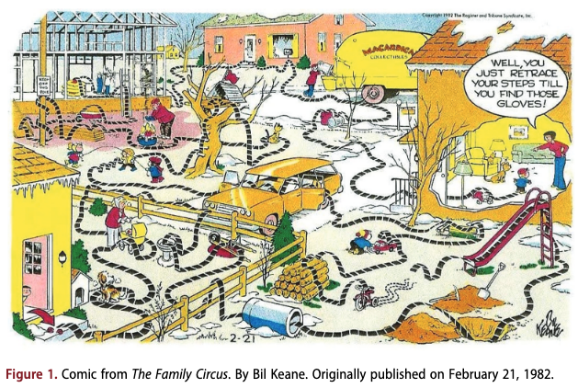


Slide 3
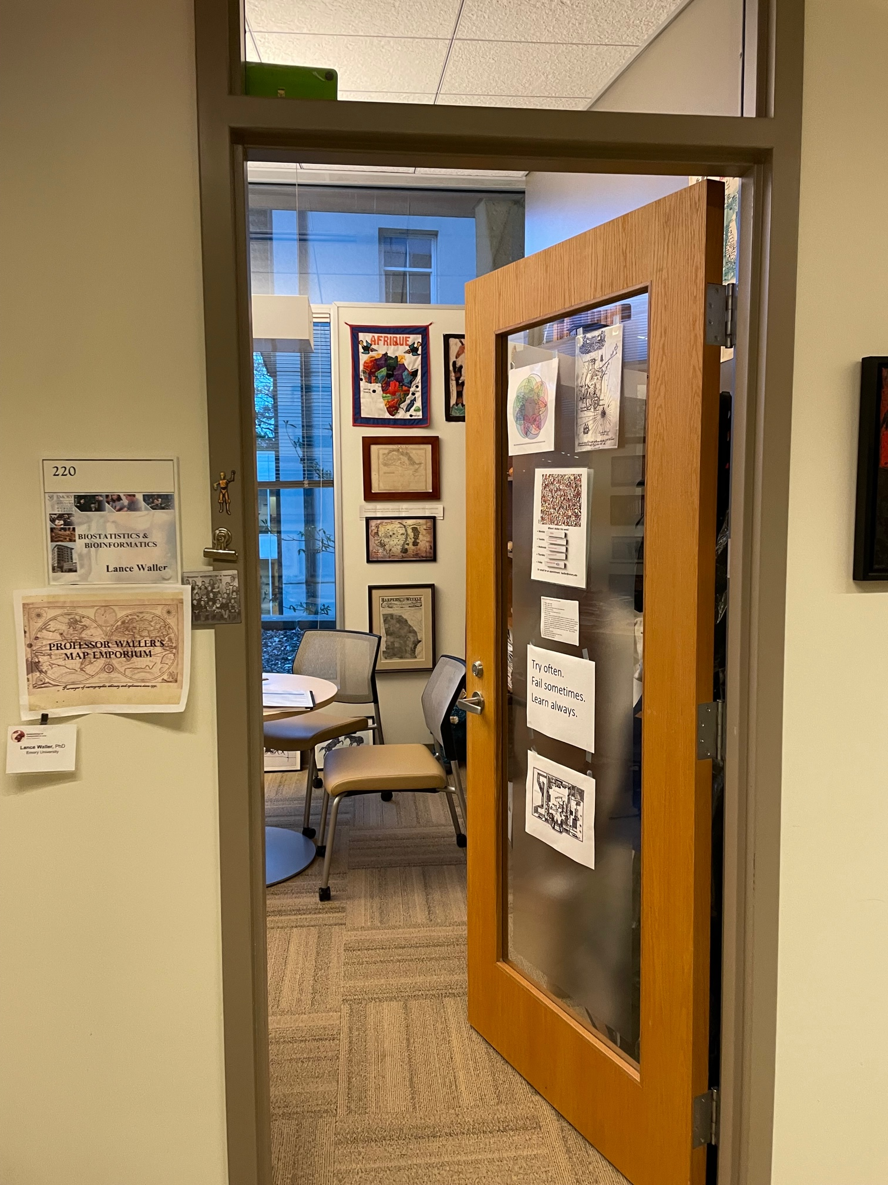
Maps: A Statistical View
Lance A. Waller, Ph.D.
Department of Biostatistics and Bioinformatics
Rollins School of Public Health
Emory University
April 2025

Slide 4
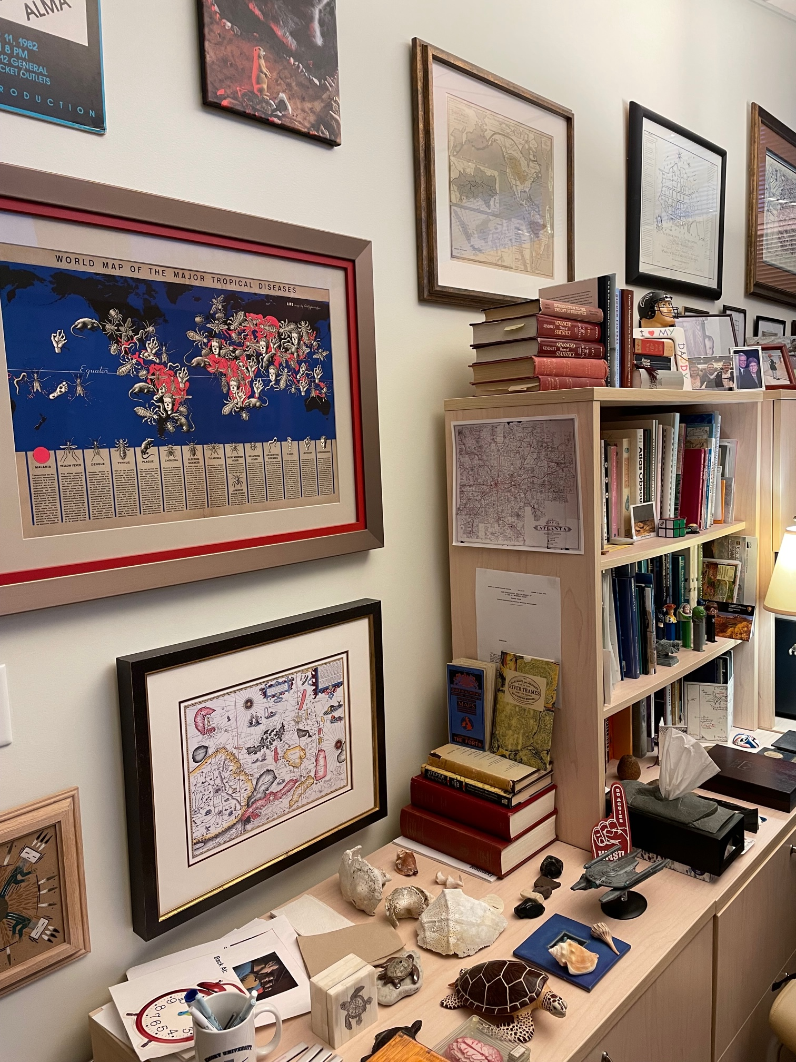
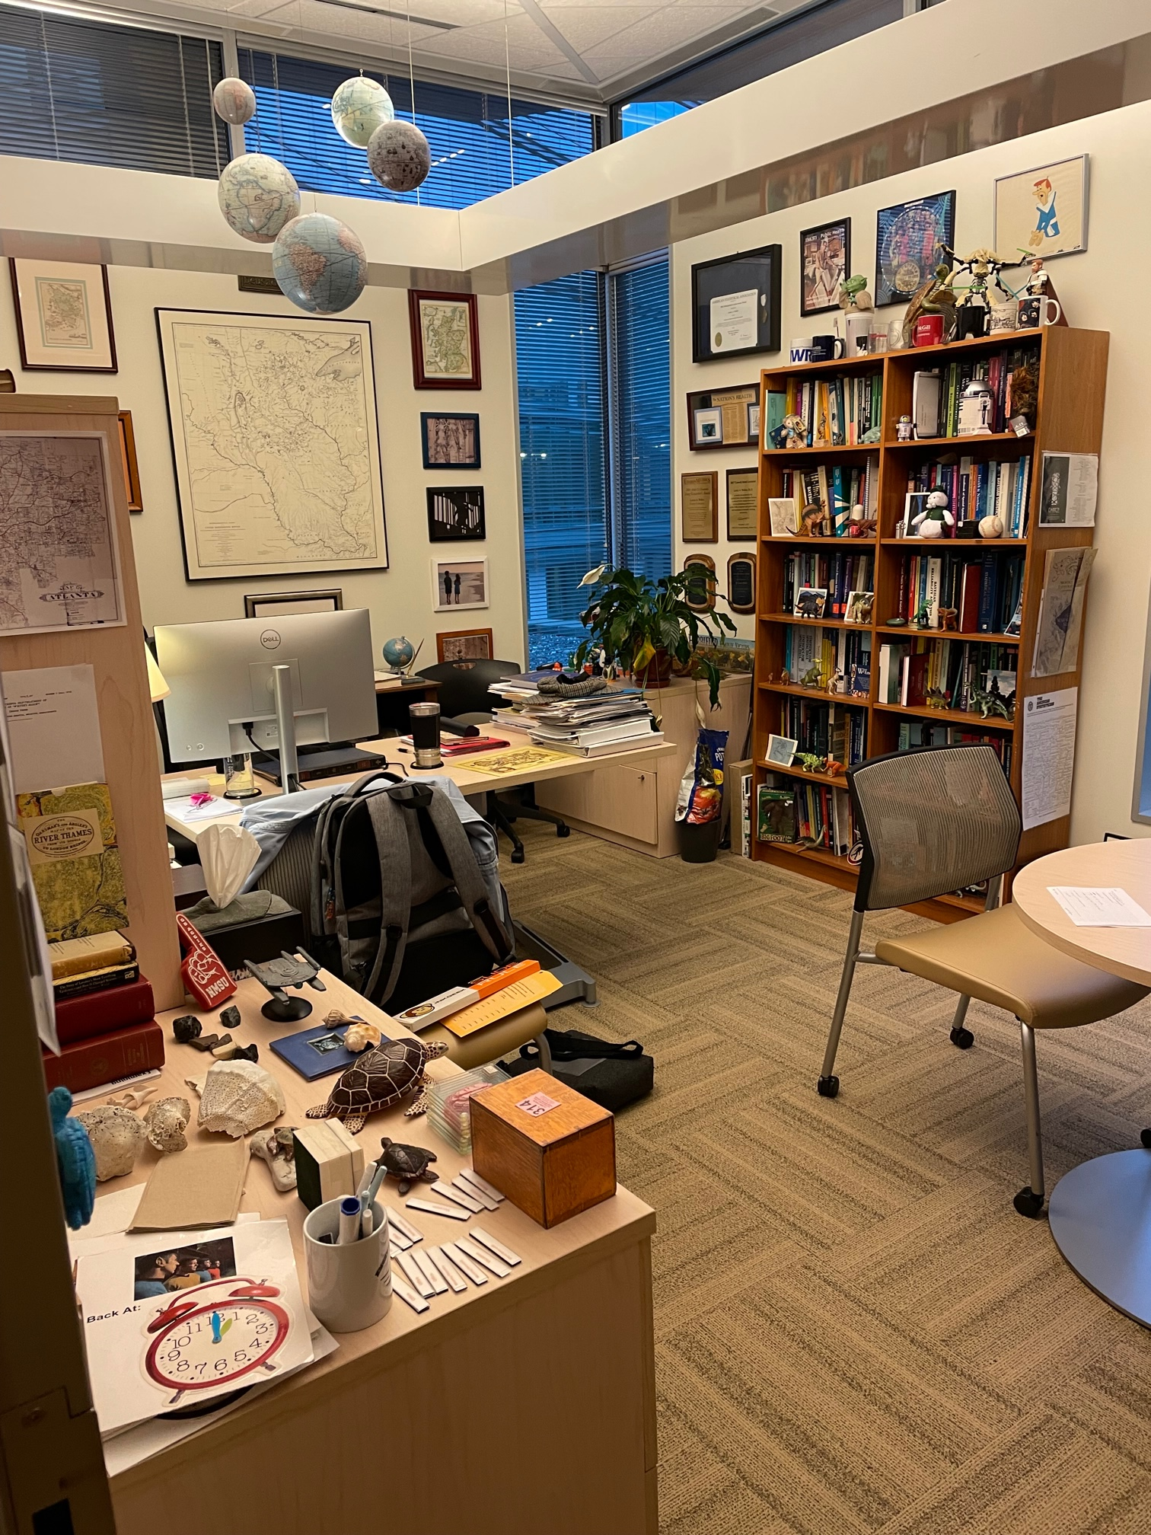

Slide 5
David Wheeler
PhD Geography, MS Statistics
Postdoc, Emory
MPH, Harvard
Postdoc, National Cancer Institute
Insightful, creative, disciplined, a wonderful colleague.
And we collaborated on maps and statistics…two of my maps before and two during these collaborations:

Slide 6
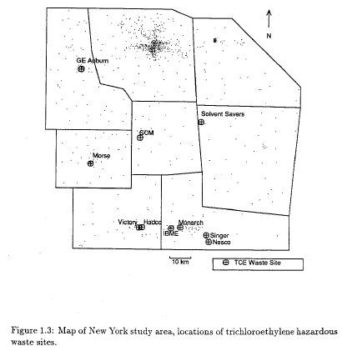
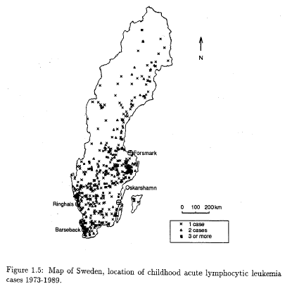
Some of my first research maps (Waller, 1992)

Slide 7
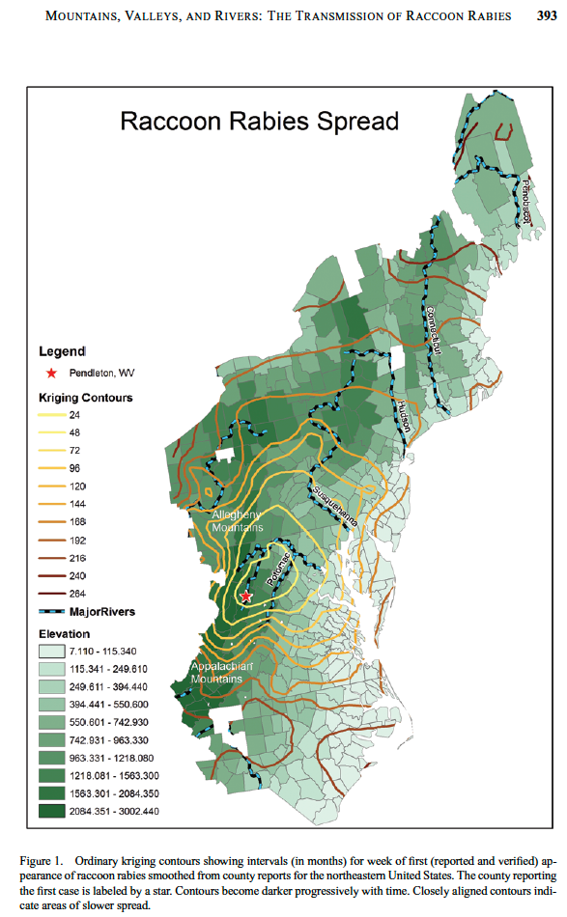
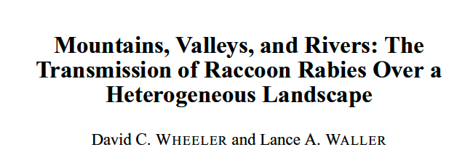

Raccoon Rabies
Best Paper in JABES 2008-2009

Slide 8
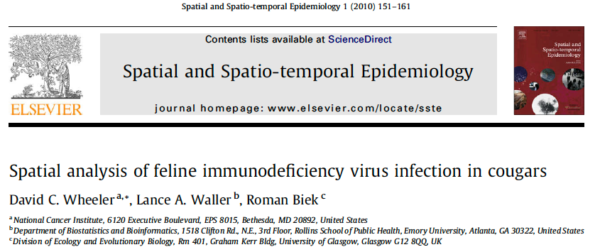
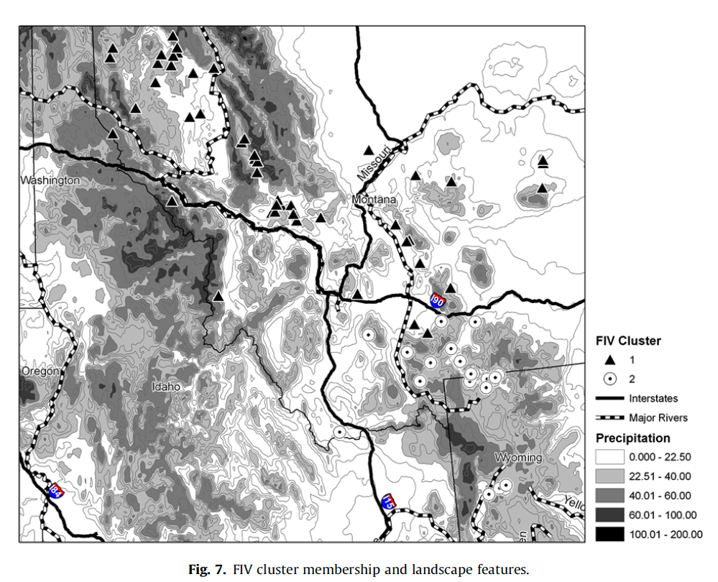
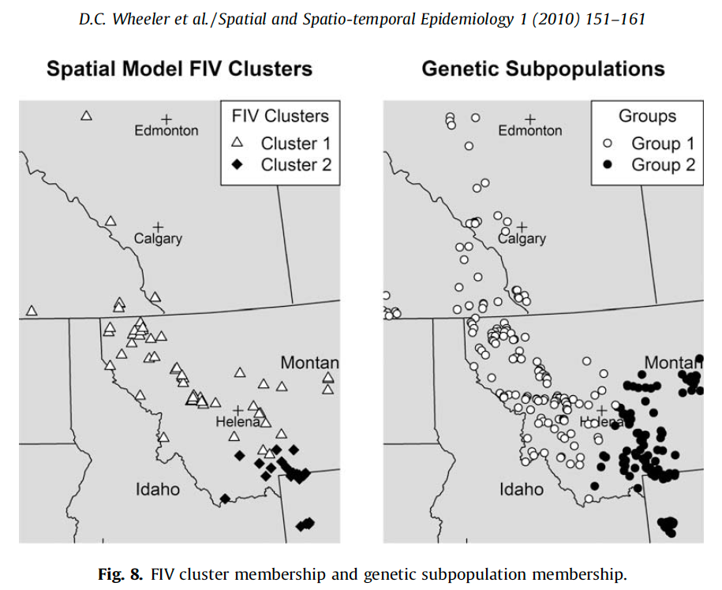
What does a map add?

Slide 9

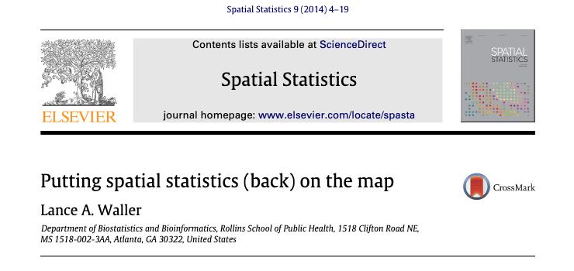
Two references: 2024 and 2014

Slide 10
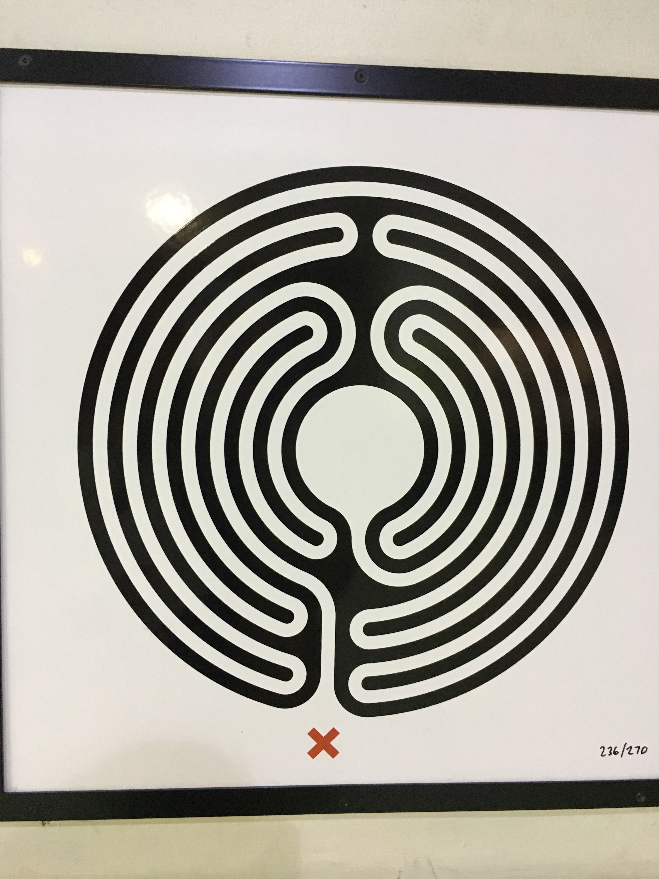
You are here…
Labyrinth art by Mark Wallinger, London Underground
https://art.tfl.gov.uk/labyrinth/about/

Slide 11
Outline
Maps Fascinate
Maps Communicate (Maps as Visualizations)
Maps Integrate (Maps as Data)
Maps Evaluate (Maps as Statistics)

Slide 12
Maps Fascinate

Slide 13
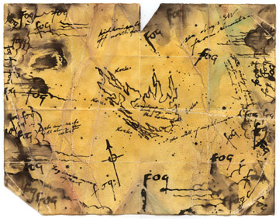
Great stories often begin with: “I have in my possession a map…”
http://www.danielreeve.co.nz/KingKong/

Slide 14
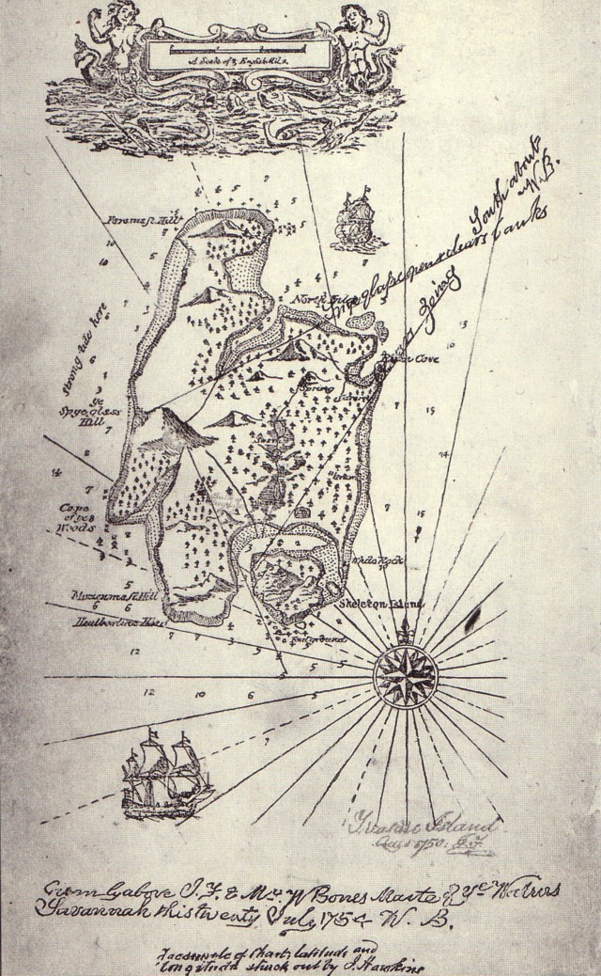
http://www.answers.com/topic/treasure-map

Slide 15
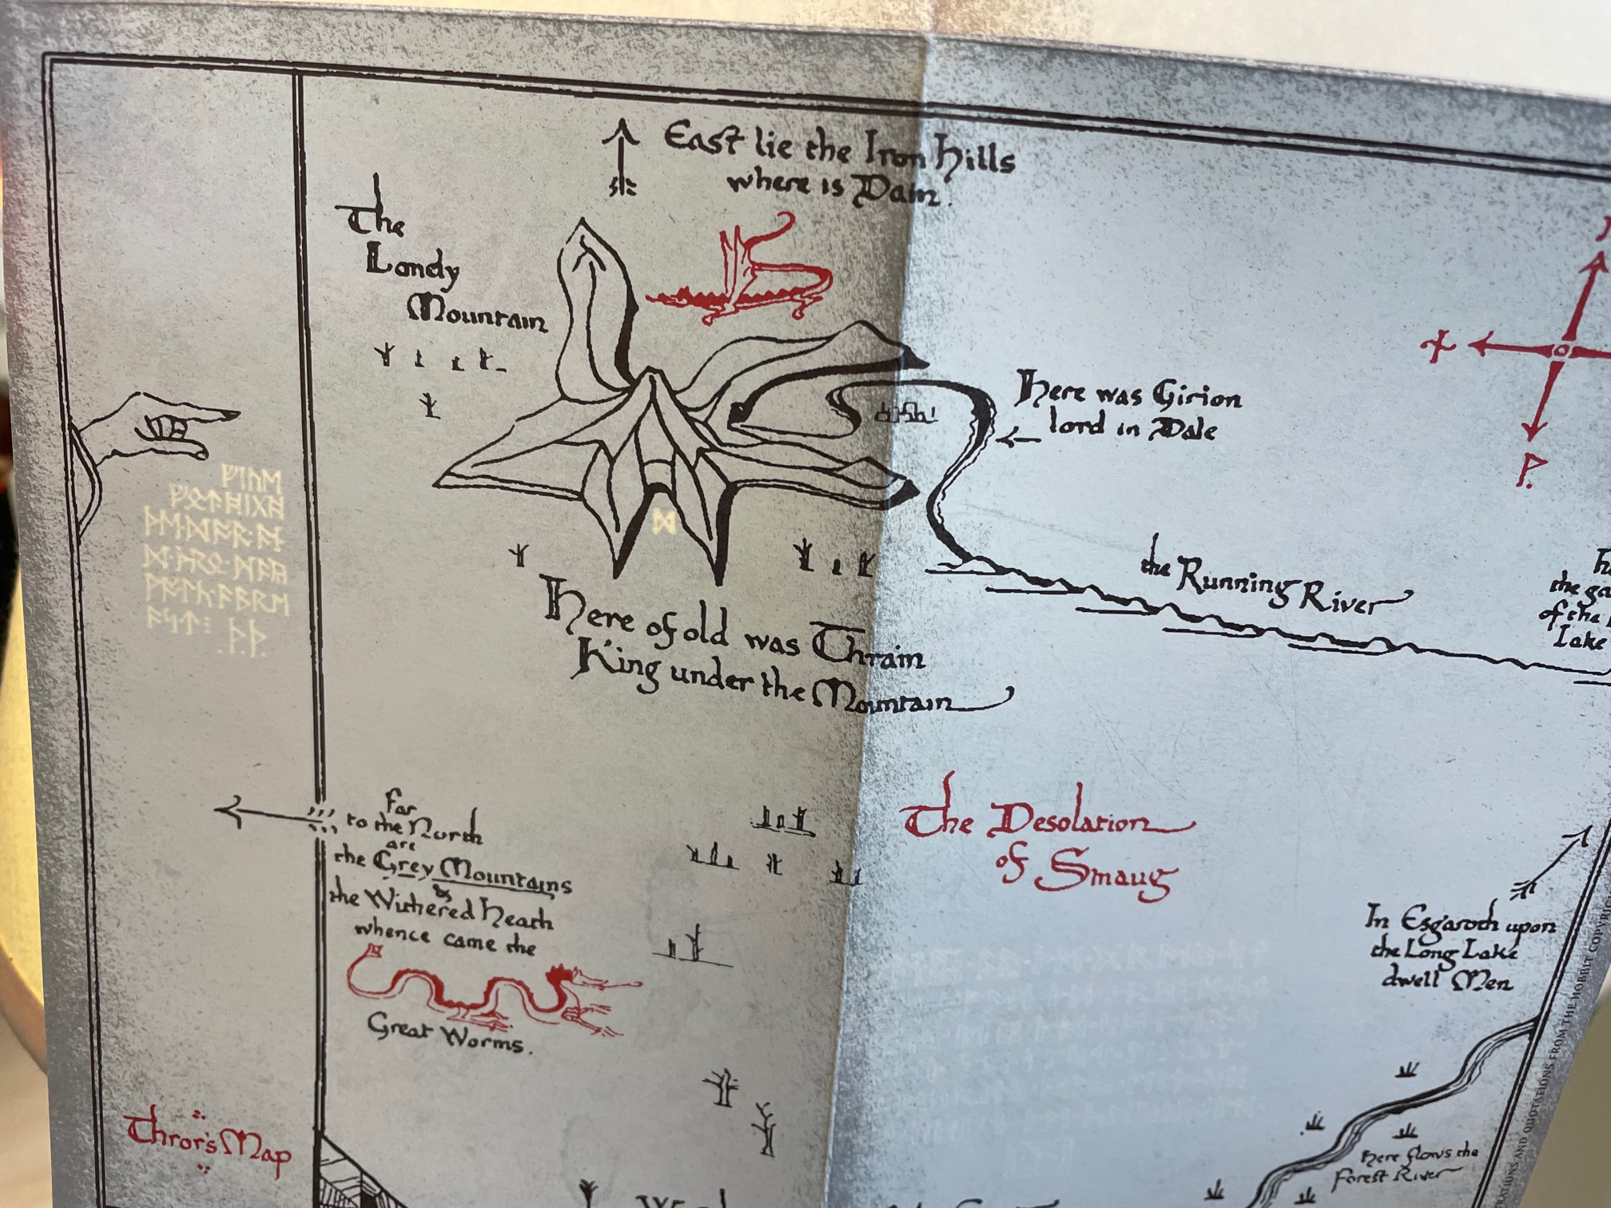

Slide 16
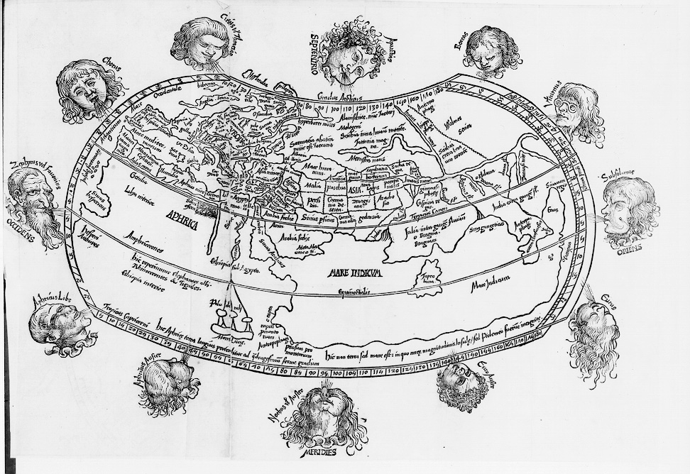
Maps summarize what we know…

Slide 17
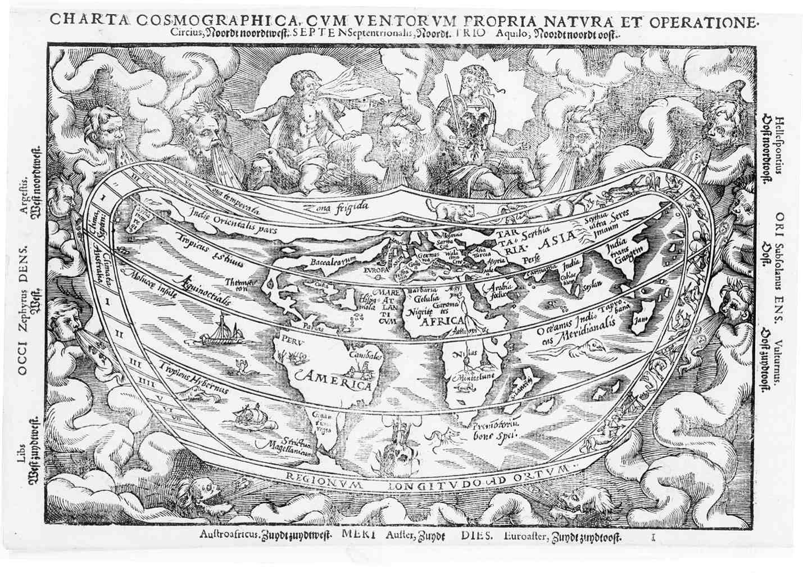

Slide 18
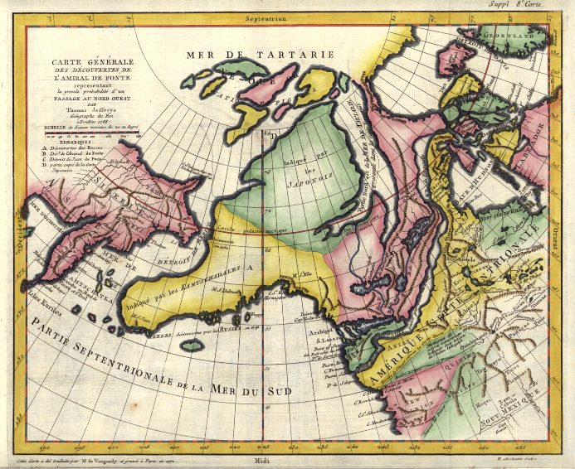
Or what we hope to see…
https://library.princeton.edu/visual_materials/maps/websites/northwest-passage/imaginary-voyages.htm
Robert de Vaugondy, Didier, 1723-1786 “Carte Générale Des Découvertes De l'Admiral de Fonte representant la grande probabilité d'un Passage Au Nord Ouest”(1772). Copperplate map, 26.5 x 34.6 cm., handcolored. This French version of a 1768 map by Thomas Jefferys appeared in Denis Diderot's Encyclopédie; ou, Dictionnaire raisonné des sciences . . . Supplement, vol. 3 (Paris, 1779).

Slide 19
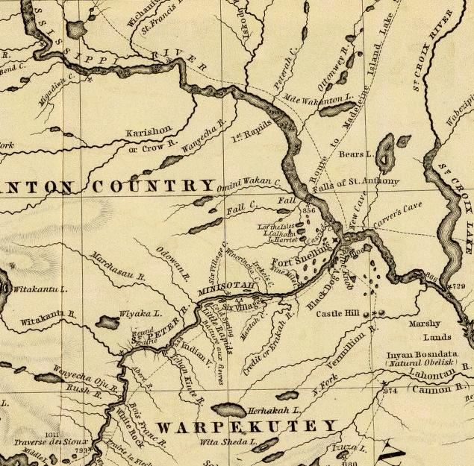
Or what we are allowed to see…

Slide 20
Maps Communicate (Maps as Visualizations)

Slide 21
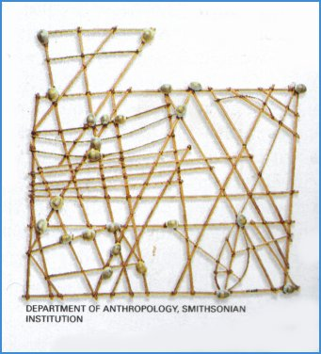
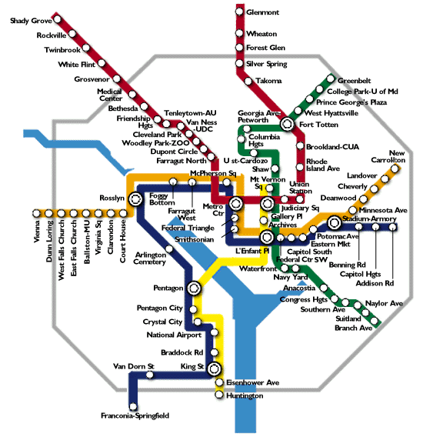
Maps get us from here to there…
http://www.janeresture.com/voyaging/main.htm
http://www.washingtonpost.com/wp-srv/local/longterm/metro/front.htm

Slide 22
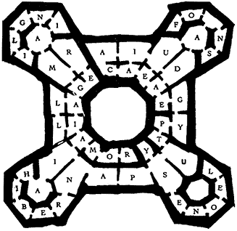
Maps hold clues…
Library Map from The Name of the Rose by Umberto Eco

Slide 23
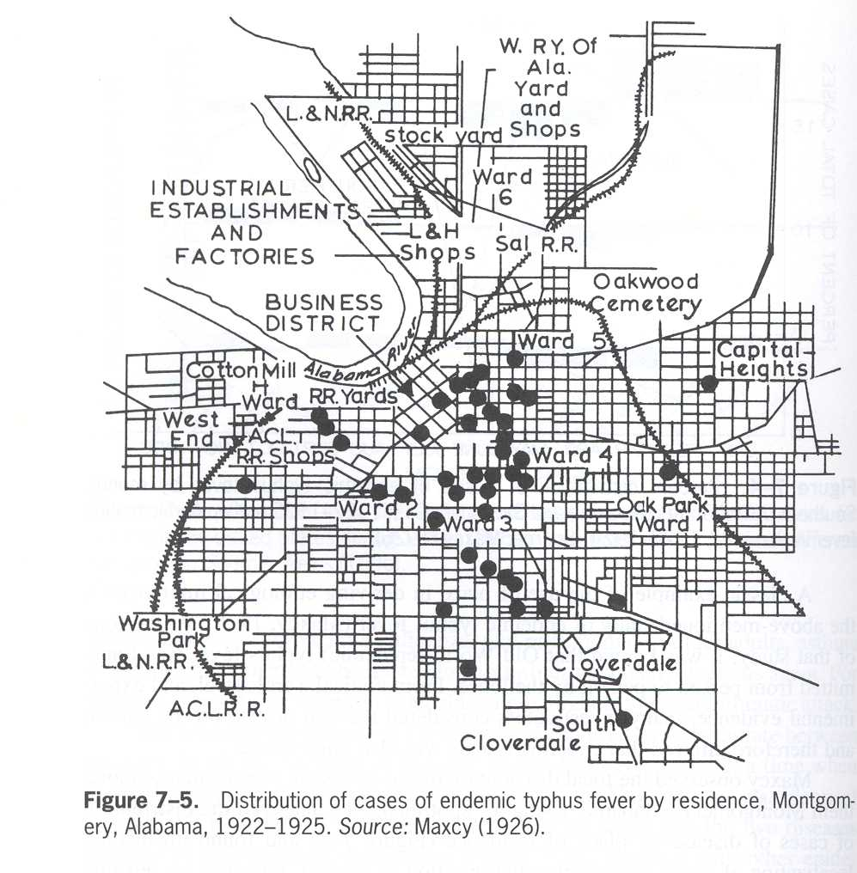
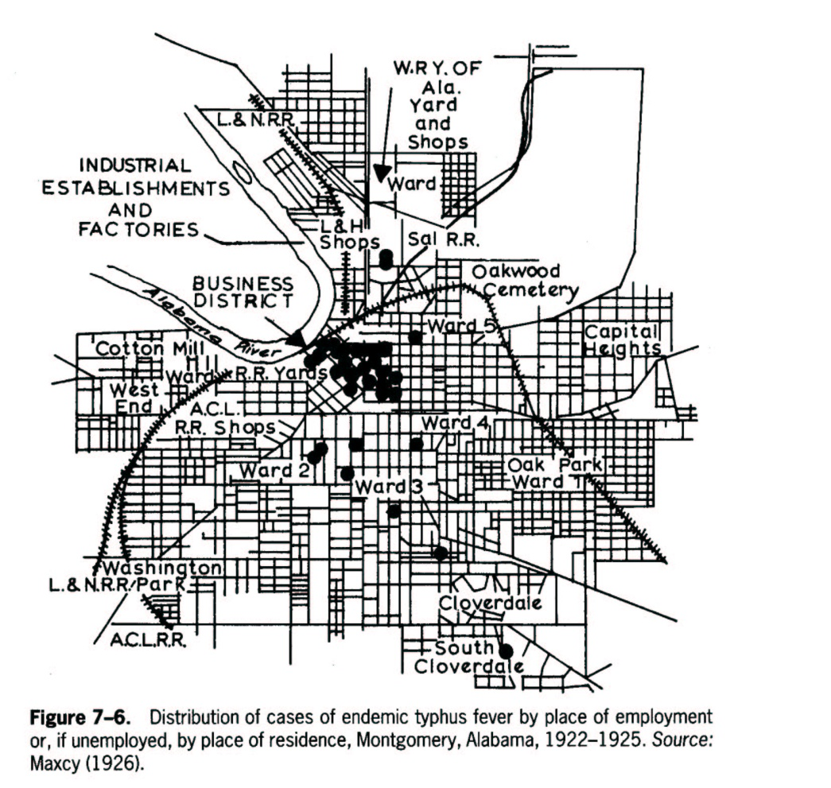
Place of residence:
But may not reveal them immediately…
Place of employment:
Lilienfeld, D.E. and Stolley, P.D. (1994) Foundations of Epidemiology,
Third Edition. Oxford University Press: New York, pp. 136-140.

Slide 24
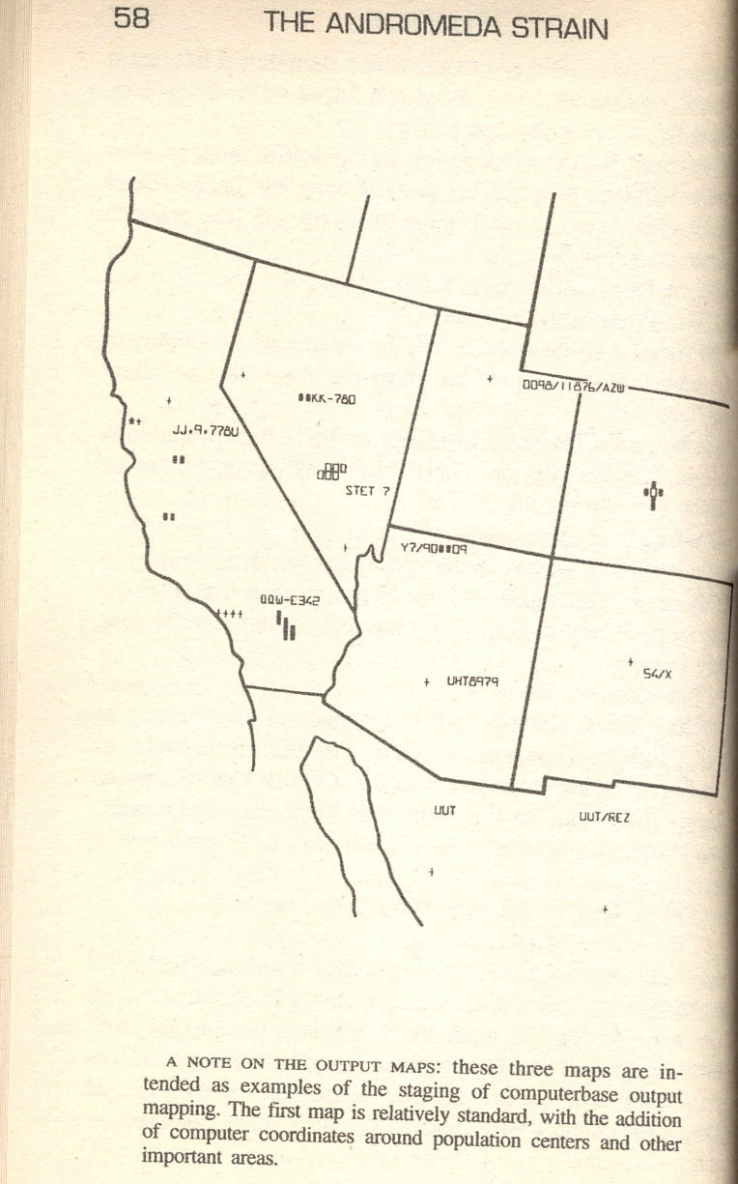
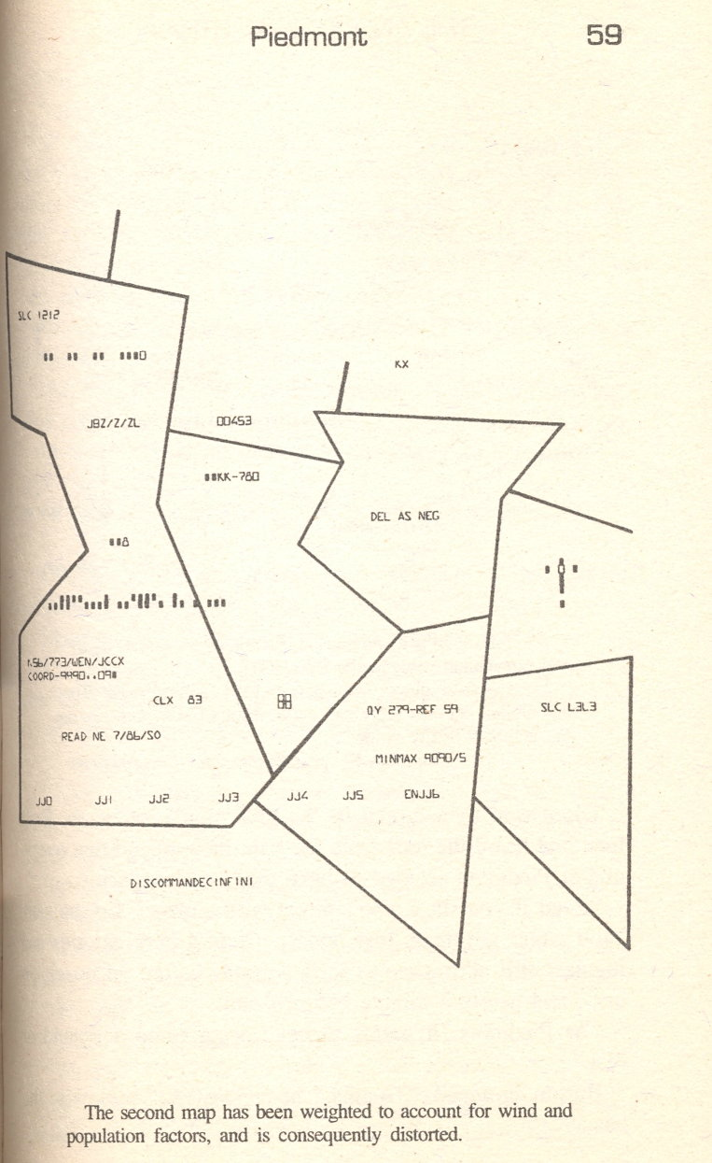
And not without some work…
Wind-adjusted cartogram from The Andromeda Strain by Michael Crichton

Slide 25
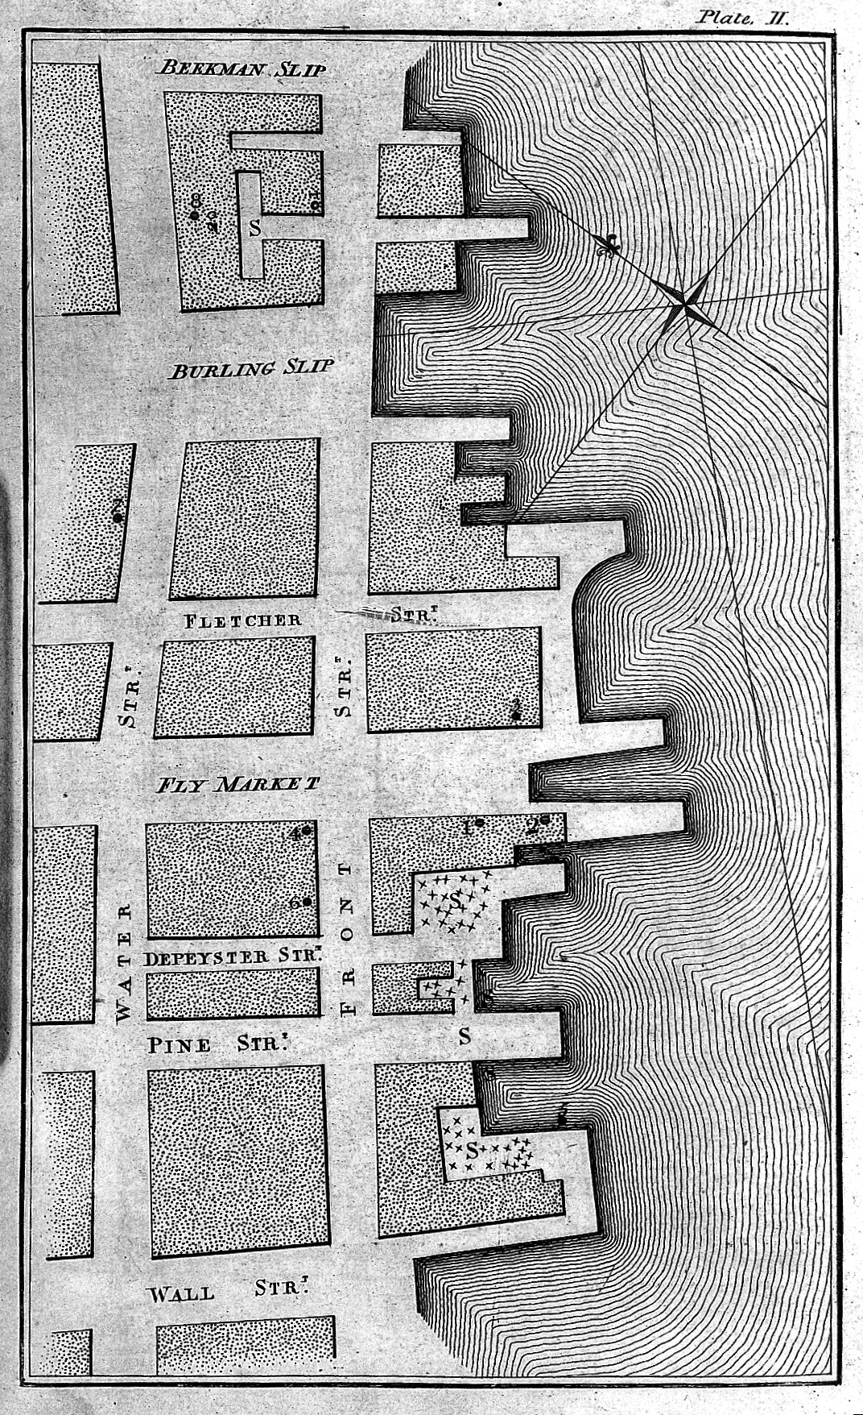
Interpretation can be tricky…
Valentine Seaman (1798), Yellow fever in New York City
Concentration of cases coincident with concentration of mosquitos.
Seaman’s interpretation: “…circumstances favoring the rise of putrid miasmata, equally favor the generation of these insects” (quoted in Stevenson, 1965)

Slide 26
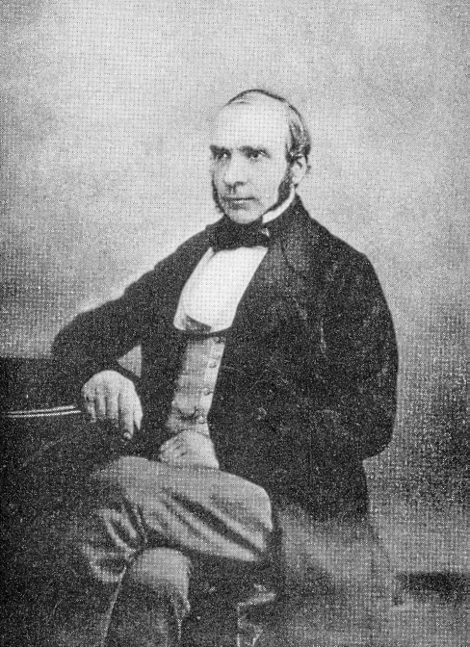

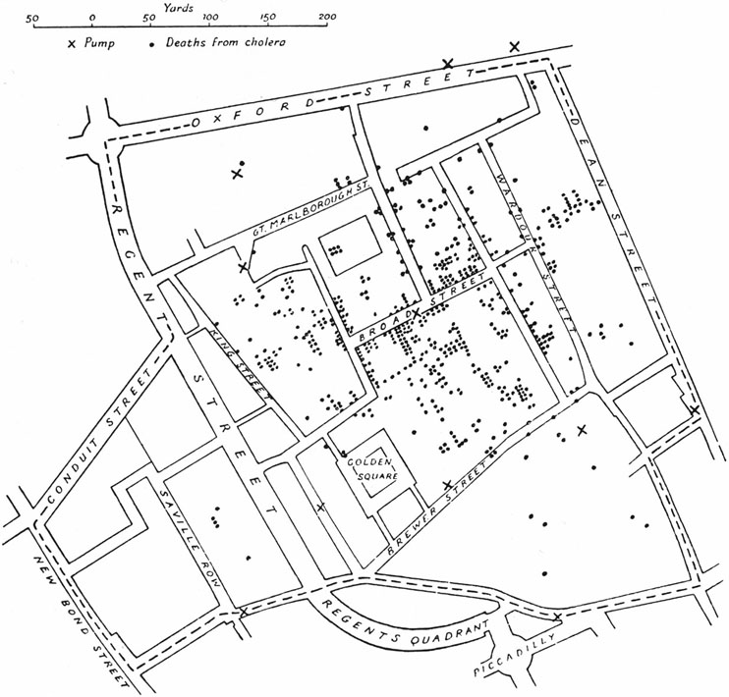
John Snow
!
Snow, J. (1949) Snow on Cholera.
Oxford University Press: London.

Slide 27
Public Health Data Science circa 1854
Koch (2005) Cartographies of Disease: Maps, Mapping, and Medicine. ESRI Press.

Slide 28
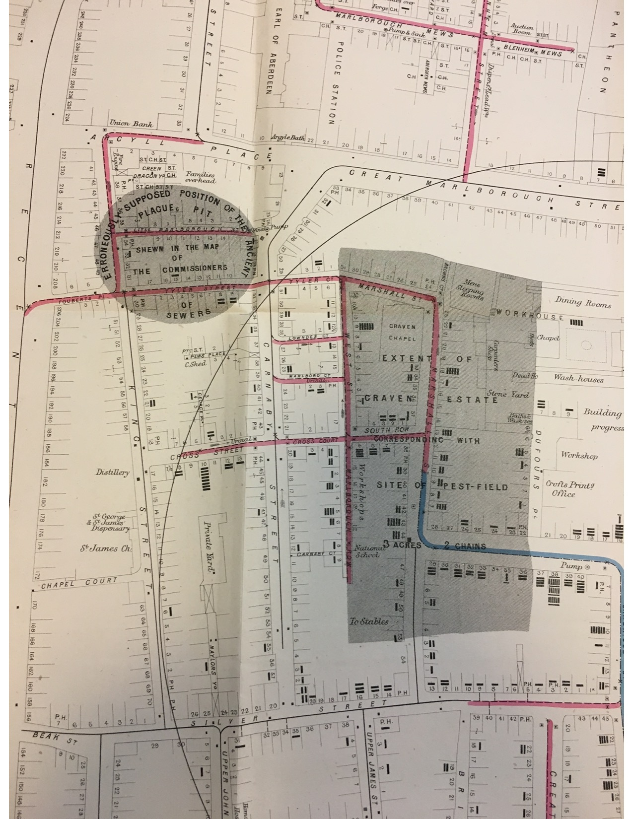
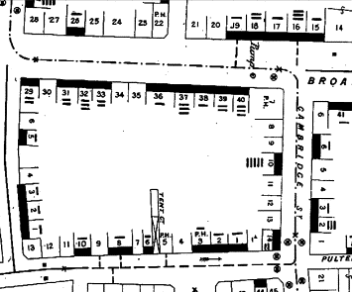
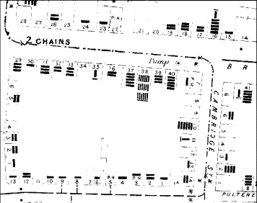
Snow’s was not the only map…
Brody et al. (2000) Map-making and myth-making in Broad Street: the London cholera epidemic, 1854. Lancet.
Koch (2005) Cartographies of Disease: Maps, Mapping, and Medicine. ESRI Press.
Johnson (2006) The Ghost Map. Riverhead Books

Slide 29
Board of Health Conclusion
“This certainly looks more like the effect of an atmospheric cause than any other; if it were owing to the water, why should not the cholera have prevailed equally everywhere where the water was drunk?” (Parkes, 1855)
Same data, similar map, different conclusion.
It is hard not to see what we are looking for…

Slide 30
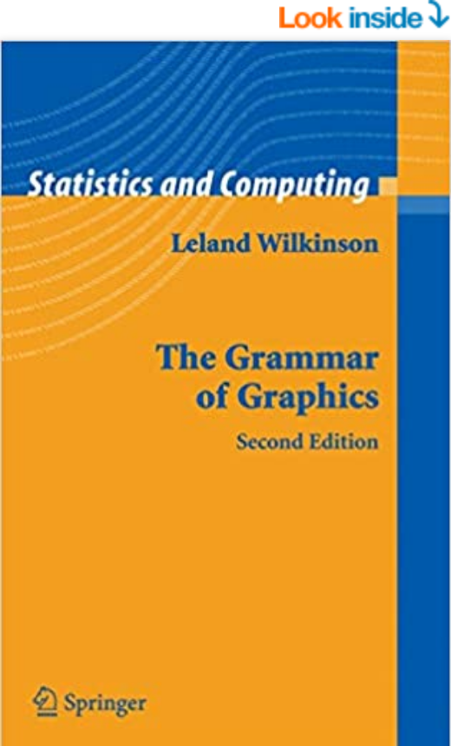
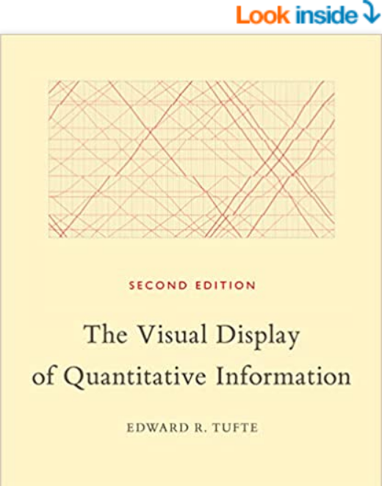
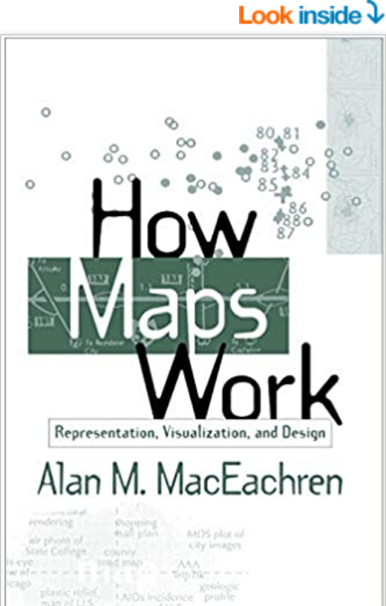
Can we communicate better?
Statistical
Graphics
Data
Visualization
Thematic
Cartography

Slide 31
Problem
A good map of bad data is more believable than a bad map of good data.
What makes a good map (of good data)?

Slide 32
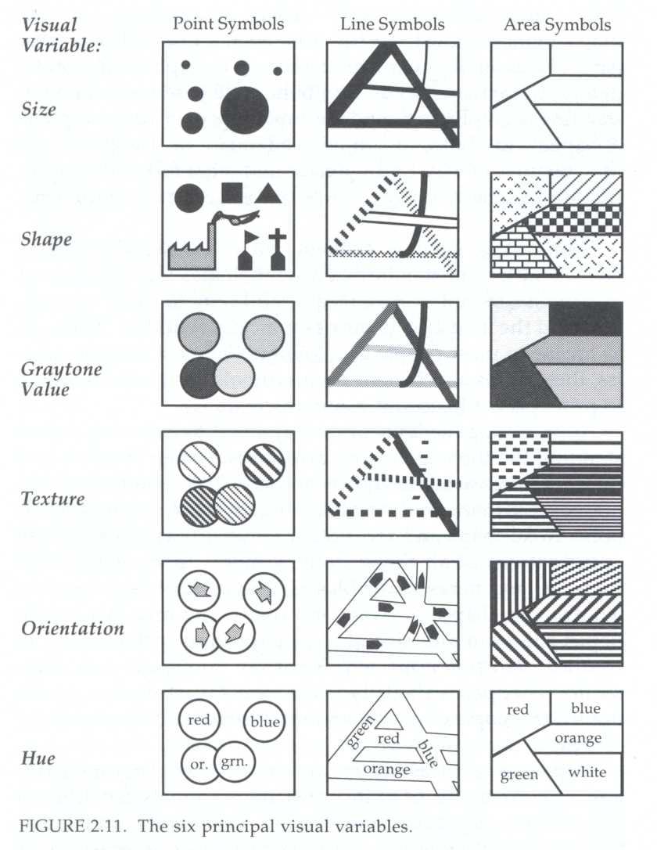
Bertin’s Visual Variables
Bertin (1983), Monmonier (1996), MacEachren (1995).
Which symbols best convey what types of information?

Slide 33
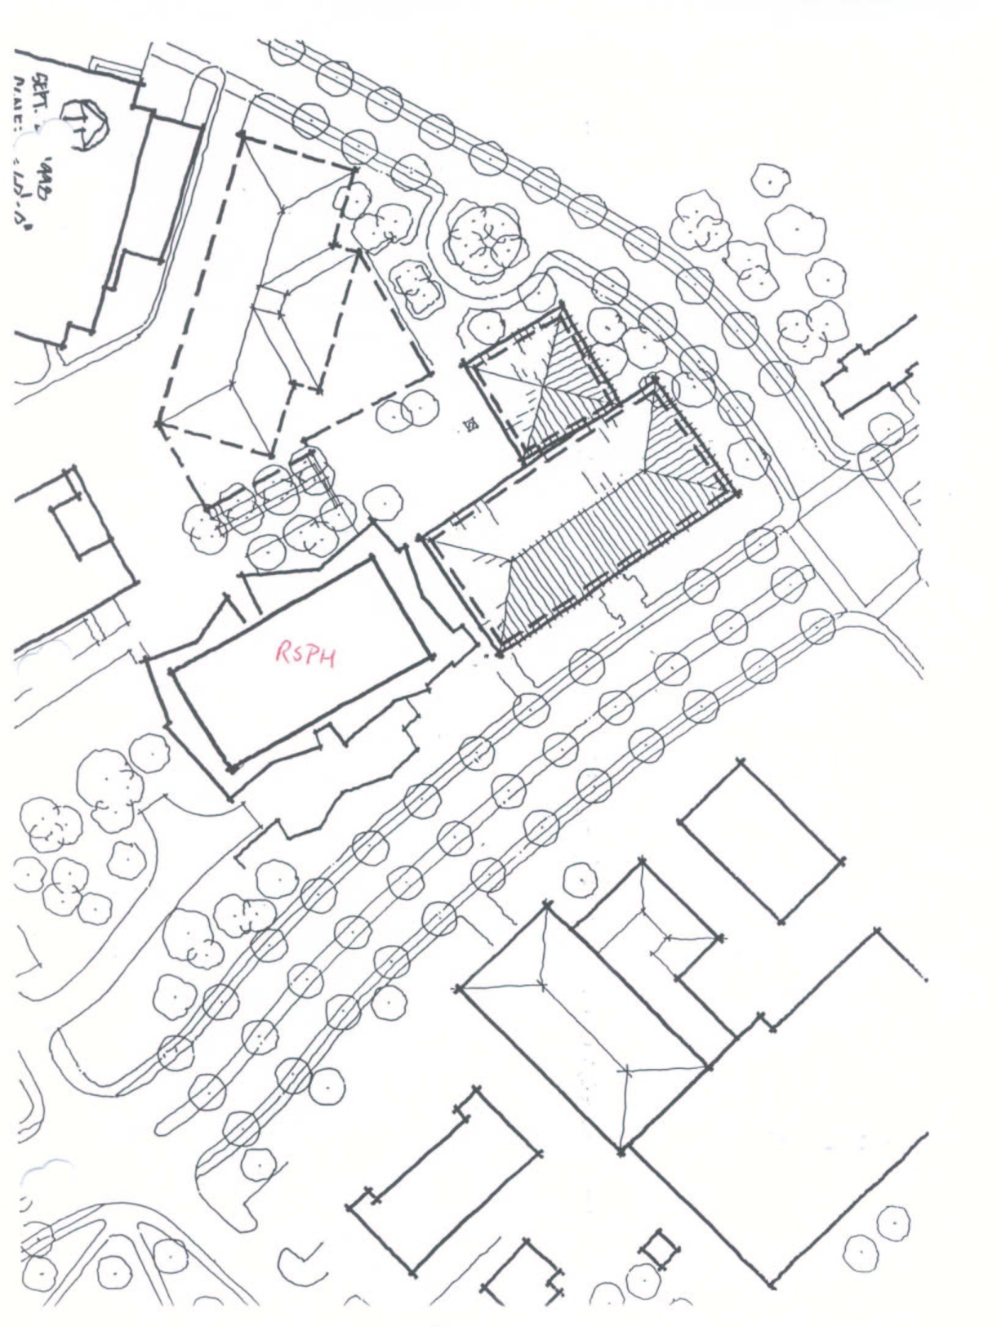
Persuasive visualization: The power of trees.
The “tree stamp” often shows a proposed building fitting into the environment.
How to Lie with Maps by Mark Monmonier
Proposal for Nell Hodgson Woodruff School of Nursing
Building.

Slide 34
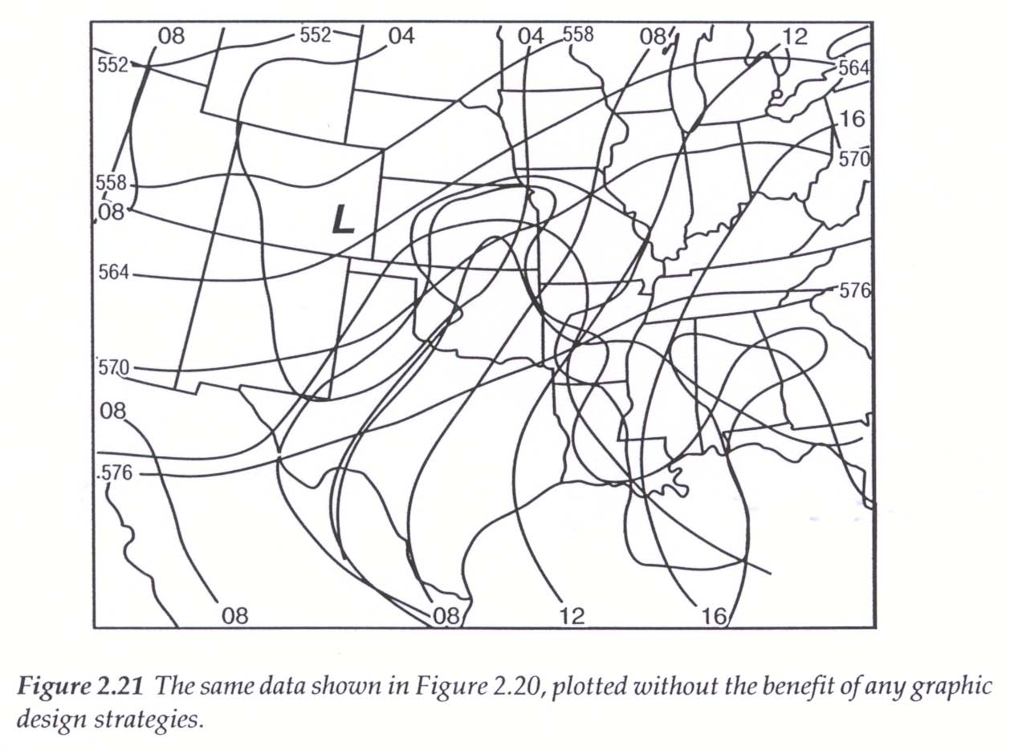
Visualizing seven layers of data
From MacEachren 1994, Some Truth with Maps, p. 28

Slide 35
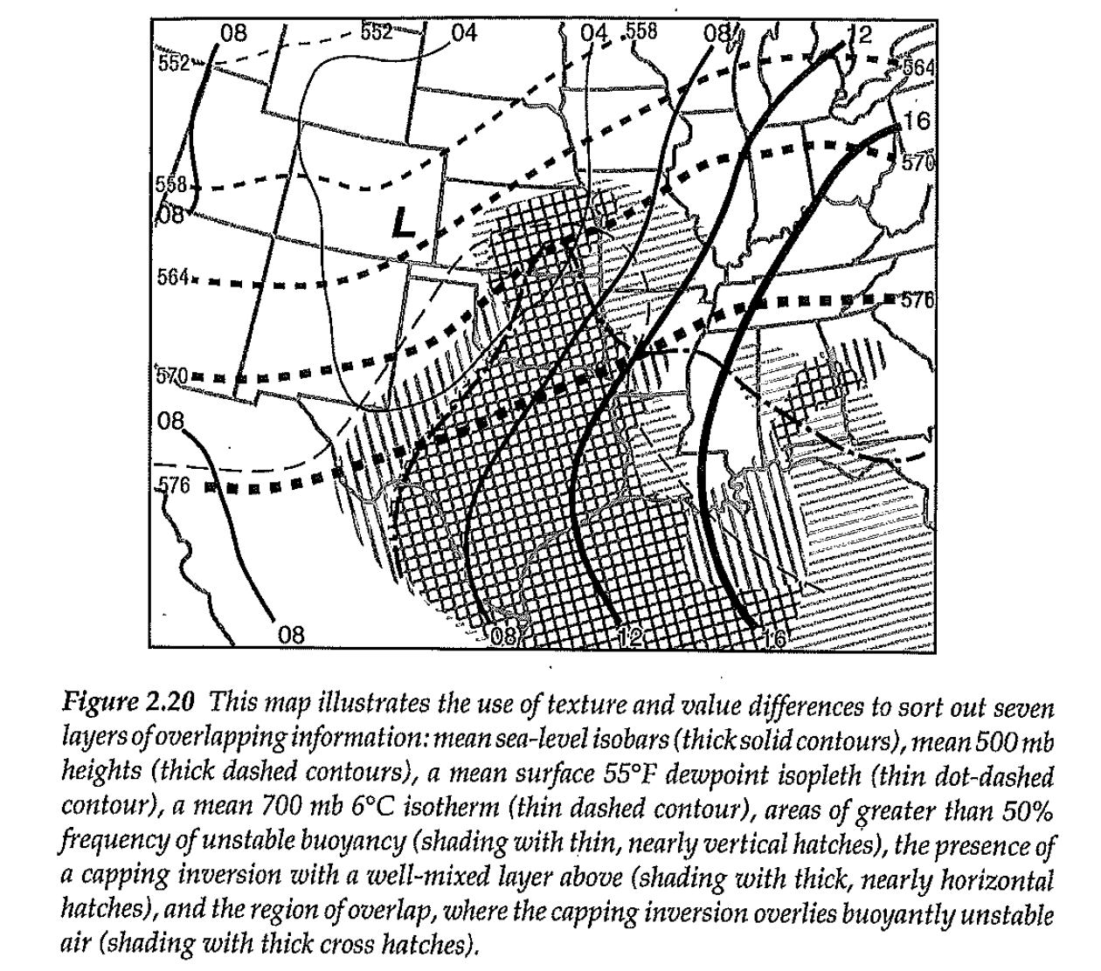
Seven layers using texture
From MacEachren 1994, Some Truth with Maps, p. 28

